Slide 1


Adrián Valdavida
01/2026

Slide 2
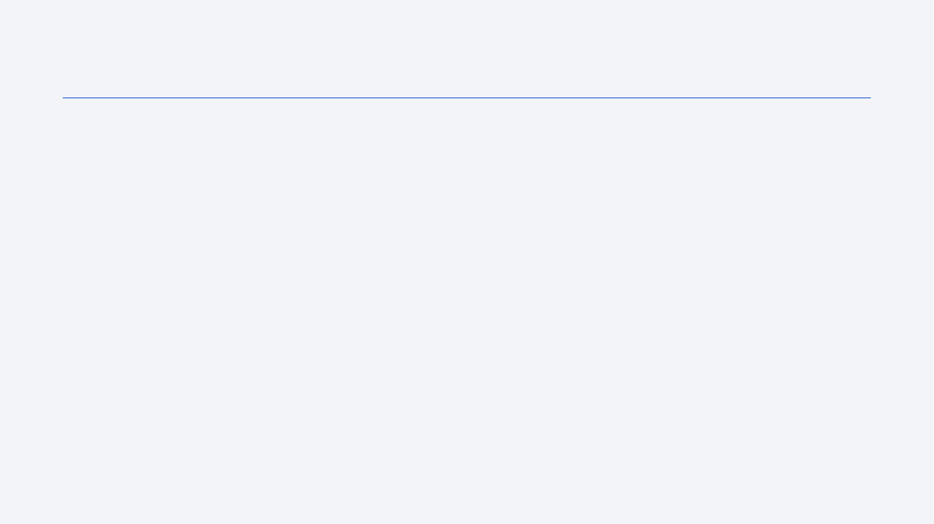
Outline
Executive Summary
Introduction
Methodology
Results
Conclusion
Appendix

Slide 3
Executive Summary
In this project, I applied a full data science pipeline: data cleaning, feature engineering, and exploratory analysis, followed by training and tuning several classification models to predict Falcon 9 landing success.
Overall, the models reached a solid test accuracy, with Logistic Regression, SVM and KNN performing similarly, while the Decision Tree tended to overfit. The analysis also revealed that launch site, orbit type, and payload play a central role in landing success

Slide 4
Introduction
SpaceX revolutionized the space industry by making Falcon 9 first stages reusable, dramatically cutting launch costs from over $60 million to around $30 million per flight. This project uses historical SpaceX launch data covering flight numbers, launch sites, payload masses, orbits, and landing outcomes to analyze reusability patterns.
The key question is: which factors most influence whether the first stage successfully lands after separation? Specifically, we want to determine the impact of launch site, orbit type, payload mass, and mission characteristics on landing success rates, and build predictive models to estimate future outcomes.

Slide 5

Section 1

Slide 6
Methodology
Executive Summary
Data collection methodology: Data was collected from SpaceX records and SQL database SPACEXTBL.
Describe how data was collected
Perform data wrangling: Missing values handled and categorical variables one-hot encoded for modeling.
Describe how data was processed
Perform exploratory data analysis (EDA) using visualization and SQL: Used visualizations and SQL queries to understand launch patterns and success factors
Perform interactive visual analytics using Folium and Plotly Dash: Created Folium maps showing launch sites and success markers by location.
Perform predictive analysis using classification models: Built and tuned Logistic Regression, SVM, KNN, and Decision Tree classifiers.
How to build, tune, evaluate classification models

Slide 7
Data Collection
Two main sources were used: a CSV dataset with Falcon 9 launch records and the SPACEXTBL SQL database containing detailed mission information.
The process followed these steps:
Connected to SQLite database → Loaded SPACEXTBL table
Queried launch sites, mission outcomes, and payload data
Imported CSV with flight details → Merged datasets
Exported to pandas DataFrame for analysis"

Slide 8
Data Collection – SpaceX API
After the general data collection overview, here are the specific SpaceX API calls used. I connected to the SPACEXTBL SQLite database via Python, queried key tables for mission details, and merged them with the Falcon 9 CSV dataset. The flowchart shows the exact process: database query to DataFrame, then merge. Full code and outputs are in this GitHub notebook for peer review: https://github.com/AValdavida/Test-Repo/blob/main/jupyter-labs-spacex-data-collection-api.ipynb
SQLite DB (SPACEXTBL) → SQL Query (pandas.read_sql) → DataFrame launches
↓
CSV Falcon9 → pd.merge() → Final Dataset

Slide 9
Data Collection - Scraping
Complementing the API data, I scraped additional real-time launch information from reliable sources. Used requests.get() on Wikipedia Falcon 9 page → BeautifulSoup parsed HTML tables → Extracted launch dates, status, and outcomes → Appended to main dataset
https://github.com/AValdavida/Test-Repo/blob/main/jupyter-labs-webscraping.ipynb
Wikipedia/SpaceX.com → requests.get() → BeautifulSoup
↓
Extract: date/outcome → CSV append

Slide 10
Data Wrangling
Identified missing PAYLOAD_MASS → Filled with median → Standardized Landing_Outcome → Created binary target (1=Success/0=Failure) → One-hot encoded Launch_Site/Orbit
Raw datasets → Check NaN/missing
↓
Fill median → Parse outcomes
↓
Binary labels → pd.get_dummies()
↓
Clean DataFrame → Modeling ready
https://github.com/AValdavida/Test-Repo/blob/main/labs-jupyter-spacex-Data%20wrangling.ipynb

Slide 11
EDA with Data Visualization
Folium maps: launch sites success by location (geospatial patterns); Bar charts: success rates by orbit/payload (categorical trends); Scatter plots: payload vs success (correlations); Line charts: success evolution over time (temporal patterns)
https://github.com/AValdavida/Test-Repo/blob/main/edadataviz.ipynb

Slide 12
EDA with SQL
The SQL queries i performed are:
%sql DROP TABLE IF EXISTS SPACEXTABLE;
%sql create table SPACEXTABLE as select * from SPACEXTBL where Date is not null
%sql SELECT * FROM SPACEXTABLE LIMIT (5);
%sql SELECT DISTINCT Launch_Site FROM SPACEXTABLE;
%sql SELECT * FROM SPACEXTABLE WHERE Launch_Site LIKE 'CCA%'LIMIT (5);
%%sql SELECT SUM(PAYLOAD_MASS__KG_) FROM SPACEXTABLE WHERE Customer = 'NASA (CRS)';
%%sql SELECT AVG(PAYLOAD_MASS__KG_) FROM SPACEXTABLE WHERE Booster_Version = 'F9 v1.1';
%sql SELECT DISTINCT Landing_Outcome FROM SPACEXTABLE;
%%sql SELECT MIN(DATE) FROM SPACEXTABLE WHERE Landing_Outcome = 'Success (ground pad)';
%%sql SELECT Booster_Version,Payload FROM SPACEXTABLE WHERE PAYLOAD_MASS__KG_ BETWEEN '4000' AND '6000' AND Landing_Outcome = 'Success (drone ship)';
%sql SELECT DISTINCT Mission_Outcome FROM SPACEXTABLE;
%%sql SELECT COUNT(CASE WHEN Mission_Outcome like '%Success%' THEN 1 END) AS Successes, COUNT(CASE WHEN Mission_Outcome like '%fail%' THEN 1 END) AS Failures FROM SPACEXTABLE;
%%sql SELECT DISTINCT Booster_Version FROM SPACEXTABLE WHERE Payload_Mass__kg_ = ( SELECT MAX(Payload_Mass__kg_) FROM SPACEXTABLE );

Slide 13
EDA with SQL
The SQL queries i performed are:
%%sql SELECT substr(Date,6,2) AS Month, Landing_Outcome, Booster_Version, Launch_Site FROM SPACEXTABLE WHERE substr(Date,0,5)='2015' AND (Landing_Outcome LIKE '%drone ship%' OR Landing_Outcome LIKE '%False drone ship%') AND Landing_Outcome LIKE '%fail%';
%%sql​ SELECT Landing_Outcome, ​ COUNT(*) as count​ FROM SPACEXTABLE​ WHERE substr(Date,0,11)>='2010-06-04' ​ AND substr(Date,0,11)<='2017-03-20'​ GROUP BY Landing_Outcome​ ORDER BY count DESC;​
https://github.com/AValdavida/Test-Repo/blob/main/jupyter-labs-eda-sql-coursera_sqllite.ipynb

Slide 14
Build an Interactive Map with Folium
folium.Circle (black outline, radius=1000m) + folium.Marker (DivIcon labels) for 4 sites (CCAFS LC-40/SLC-40, KSC LC-39A, VAFB SLC-4E); MarkerCluster (red=failed/green=success launches); PolyLine (red, weight=1) + DivIcon distance markers to coast/rail/highway/city.. Circles visualize launch volume by site; Markers provide GPS precision; Lines measure infrastructure accessibility (coast proximity for recovery ships, rail/highways for booster transport, population for safety buffers).
Circles/Markers locate sites precisely with popups; MarkerCluster differentiates success (green)/failure (red) launches; PolyLines + distance labels quantify proximities revealing optimal site criteria: coast recovery, rail/highway logistics, population safety buffers.
https://github.com/AValdavida/Test-Repo/blob/main/lab_jupyter_launch_site_location.ipynb

Slide 15
Build a Dashboard with Plotly Dash
Pie chart (success/failure rates by Launch Site dropdown); Scatter plot (Payload Mass vs Outcome, colored by Booster Version); Range Slider (Payload 0-10000+kg); Cross-filtering via callbacks updating both charts live.
Dropdown filters sites revealing success patterns (CCAFS SLC-40 highest rate); Slider tests payload-success correlation (optimal 4-6k kg range); Scatter shows Booster Version impact; Live updates enable hypothesis testing: site+payload+booster combinations.
https://github.com/AValdavida/Test-Repo/blob/main/spacex_dash_app_Con_Preguntasyrespuestas.py

Slide 16
Predictive Analysis (Classification)
Logistic Regression, SVM, KNN: accuracy 0.83 (consistent confusion matrices); Decision Tree: 0.66 (overfit). SVM selected as best performer due to balanced precision/recall across classes despite tied accuracy.
Clean DataFrame → 80/20 Train/Test Split
↓
4 Classifiers → Cross-Validation
↓
Confusion Matrix: [LR/SVM/KNN: 0.83 | DT: 0.66]
↓
**SVM Production** (best precision on both classes)
https://github.com/AValdavida/Test-Repo/blob/main/SpaceX_Machine%20Learning%20Prediction_Part_5.ipynb

Slide 17
Results
CCAFS SLC-40 highest success rate; Optimal payload 4-6k kg; Success improving over time; Sites near coast (0.51km avg) with rail/highway access.
Folium: CircleMarkers + PolyLines to coast/rail (screenshots); Dash: Site dropdown → Pie chart success + Payload slider → Scatter outcomes.
LR/SVM/KNN: 83% accuracy (confusion matrix); Decision Tree: 66% (overfit); SVM best precision/recall balance; Top features: PayloadMass + LaunchSite.
Análisis | Key Insight | Visual Tool
EDA | CCAFS SLC-40 >90% success | Folium maps + Bars
Interactive | Payload 4-6kkg optimal | Dash dropdown/slider
Predictive | SVM 83% accuracy | Confusion Matrix

Slide 18

Section 2

Slide 19
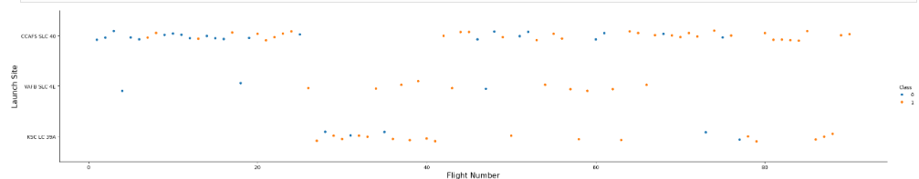
Flight Number vs. Launch Site
It can be observed that the LaunchSite "CCAFS SLC 40" is the most used, no matter the class.

Slide 20
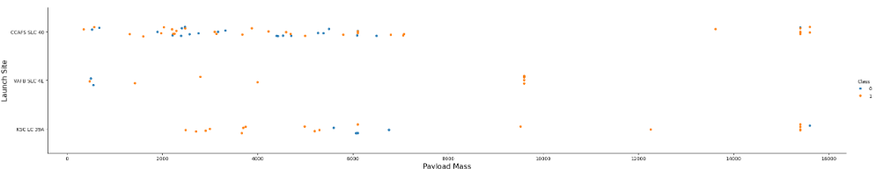
Payload vs. Launch Site
Now if you observe Payload Mass Vs. Launch Site scatter point chart you will find for the VAFB-SLC launchsite there are no rockets launched for heavypayload mass(greater than 10000).

Slide 21
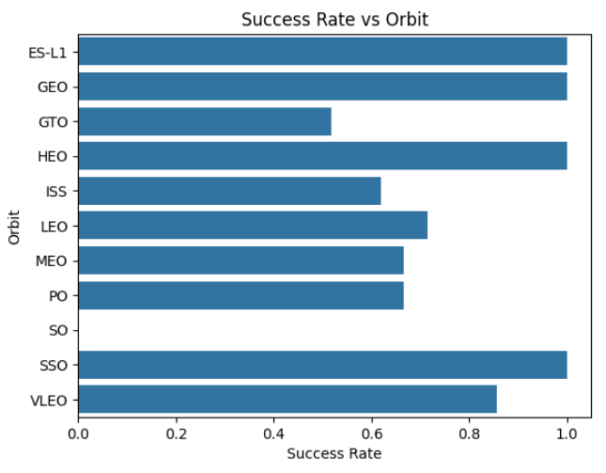
Success Rate vs. Orbit Type
The orbits with the highest success rate are ES-L1, GEO, HEO and SSO

Slide 22
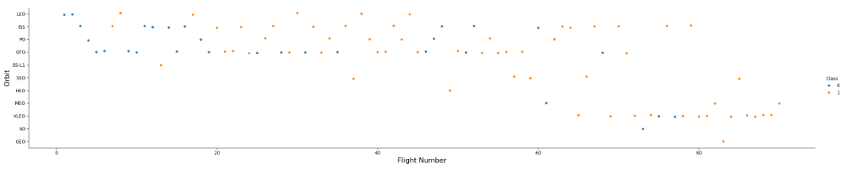
Flight Number vs. Orbit Type
You can observe that in the LEO orbit, success seems to be related to the number of flights. Conversely, in the GTO orbit, there appears to be no relationship between flight number and success.

Slide 23
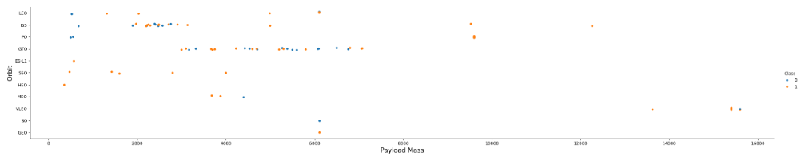
Payload vs. Orbit Type
With heavy payloads the successful landing or positive landing rate are more for Polar, LEO and ISS.
However, for GTO, it's difficult to distinguish between successful and unsuccessful landings as both outcomes are present.

Slide 24
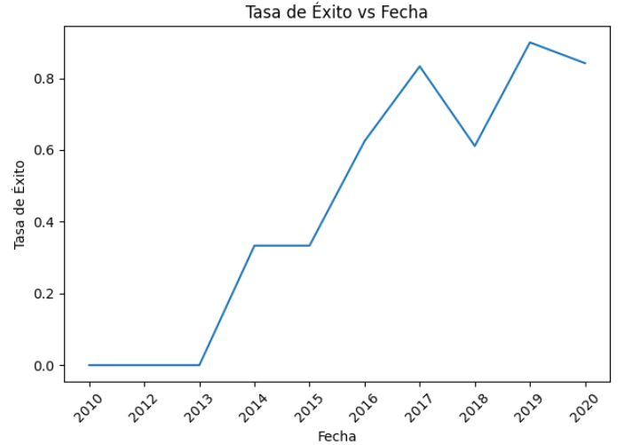
Launch Success Yearly Trend
Can observe that the success rate since 2013 kept increasing till 2020

Slide 25
All Launch Site Names
The names of the unique launch sites are: CCAFS LC-40, VAFB SLC-4E, KSC LC-39A, CCAFS SLC-40
The query: SELECT DISTINCT Launch_Site FROM SPACEXTABLE → 4 unique sites; CCAFS SLC-40 most frequent (success leader); sqlite://my_data1.db → Direct SpaceX API data access.

Slide 26
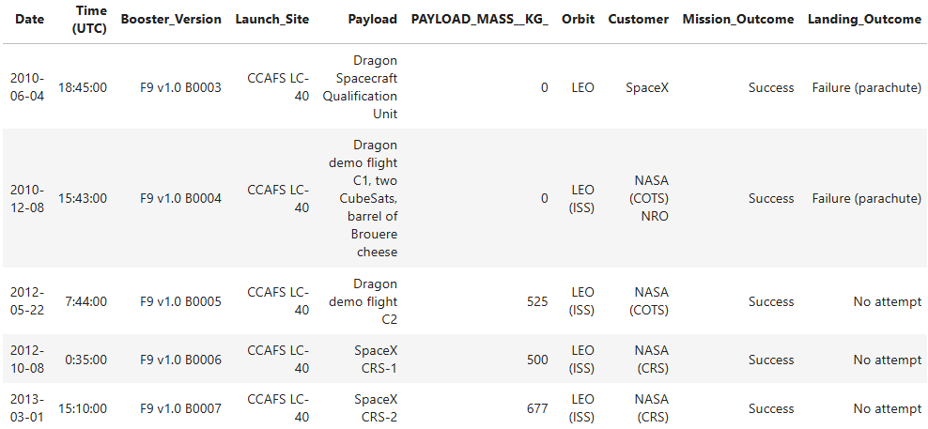
Launch Site Names Begin with 'CCA'
CCAFS LC-40: 5 early missions (2010-2013); F9 v1.0 boosters B0003-B0007; Dragon qualification + CRS-1/2; All mission success, landings: 2x parachute failure, 3x no attempt.
SELECT * FROM SPACEXTABLE WHERE Launch_Site LIKE 'CCA%' LIMIT 5 → CCAFS LC-40 dominates early Falcon 9 program; Early landing attempts failed (parachutes); Shows site evolution from Dragon demos to operational CRS missions.

Slide 27
Total Payload Mass
The query: SELECT SUM(PAYLOAD_MASS__KG_) FROM SPACEXTABLE WHERE Customer = 'NASA (CRS)'
Results: NASA (CRS): 45,596 kg total payload across Dragon CRS missions to ISS.
This sustained Falcon 9 development enabling reusable landing tech. Primary customer driving launch cadence.

Slide 28
Average Payload Mass by F9 v1.1
The query: SELECT AVG(PAYLOAD_MASS__KG_) FROM SPACEXTABLE WHERE Customer = 'NASA (CRS)'
Results: NASA CRS: 2928.4 kg avg payload per mission
Average payload mass per CRS mission to ISS; Reveals typical Dragon cargo capacity; Consistent ~2-3t per flight pattern.

Slide 29
First Successful Ground Landing Date
The query: SELECT MIN(DATE) FROM SPACEXTABLE WHERE Landing_Outcome = 'Success (ground pad)'
Results: 2015-12-22
Falcon 9 Full Thrust first ground pad success (Orbcomm OG2); Marked reusability breakthrough; 5 years from first launch (2010) to landing success.

Slide 30
Successful Drone Ship Landing with Payload between 4000 and 6000
The query: SELECT Booster_Version,Payload WHERE PAYLOAD_MASS__KG_ BETWEEN '4000' AND ''6000 AND Landing_Outcome='Success (drone ship)'
Results:
Booster | Payload
F9 FT B1022 | JCSAT-14
F9 FT B1026 | JCSAT-16
F9 FT B1021.2 | SES-10
F9 FT B1031.2 | SES-11/EchoStar 105
Optimal payload range (4-6k kg) drone ship landings; Falcon 9 FT Block 3 boosters; SES/JCSAT telecom sats.

Slide 31
Total Number of Successful and Failure Mission Outcomes
The query: %%sql SELECT
COUNT(CASE WHEN Mission_Outcome like '%Success%' THEN 1 END) AS Successes,
COUNT(CASE WHEN Mission_Outcome like '%fail%' THEN 1 END) AS Failures
FROM SPACEXTABLE;
Results:
99.0% mission success rate; Single failure in SPACEXTABLE dataset; Demonstrates Falcon 9 operational maturity.
Successes | Failures
100 | 1

Slide 32
Boosters Carried Maximum Payload
The query: %%sql SELECT DISTINCT Booster_Version FROM SPACEXTABLE WHERE Payload_Mass__kg_ = ( SELECT MAX(Payload_Mass__kg_) FROM SPACEXTABLE );
Results:
Booster_Version
F9 B5 B1048.4 F9 B5 B1049.4 F9 B5 B1051.3 F9 B5 B1056.4 F9 B5 B1048.5 F9 B5 B1051.4
F9 B5 B1049.5 F9 B5 B1060.2 F9 B5 B1058.3 F9 B5 B1051.6 F9 B5 B1060.3 F9 B5 B1049.7
12 unique F9 B5 Block 5 boosters carried maximum payloads; Latest generation handles heaviest loads reliably.

Slide 33
2015 Launch Records
The query: %%sql SELECT substr(Date,6,2) AS Month, Landing_Outcome, Booster_Version, Launch_Site FROM SPACEXTABLE WHERE substr(Date,0,5)='2015' AND (Landing_Outcome LIKE '%drone ship%' OR Landing_Outcome LIKE '%False drone ship%') AND Landing_Outcome LIKE '%fail%';
Results:
2 early drone ship failures (Jan/Apr 2015); F9 v1.1 boosters B1012/B1015 from CCAFS LC-40; Offshore recovery tech still maturing.
Month | Landing_Outcome | Booster_Version | Launch_Site
01 | Failure (drone ship) | F9 v1.1 B1012 | CCAFS LC-40
04 | Failure (drone ship) | F9 v1.1 B1015 | CCAFS LC-40

Slide 34
Rank Landing Outcomes Between 2010-06-04 and 2017-03-20
Landing_Outcome | Count
No attempt | 10
Success (drone ship) | 5
Failure (drone ship) | 5
Success (ground pad) | 3
Controlled (ocean) | 3
Uncontrolled (ocean) | 2
Failure (parachute) | 2
Precluded (drone ship) | 1
Early era (2010-2017):
• 32% no attempts (10/31)
• Drone ship: 50% success (5/10)
• 3 ground pad = reusability breakthrough

Slide 35

Section 3

Slide 36
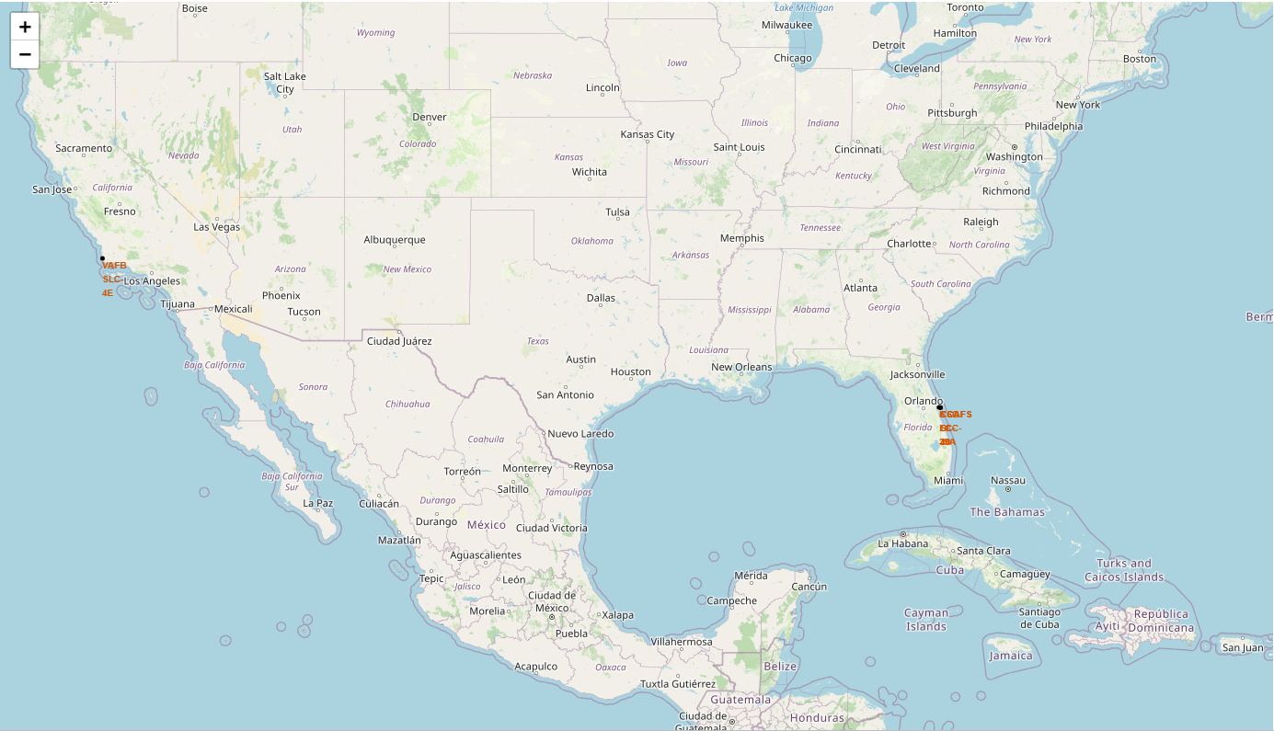
Launch sites Map
Launch sites aren't in proximity to the Ecuator line but yes they are very close to the coast. Also sites must be in a place with no residences o living areas, only launch infrastructures, near to water so all the energy displayed can't be dangerous for human life and where a hypothetical malfunction and subsequent explosion of the rocket would cause the least amount of damage.

Slide 37
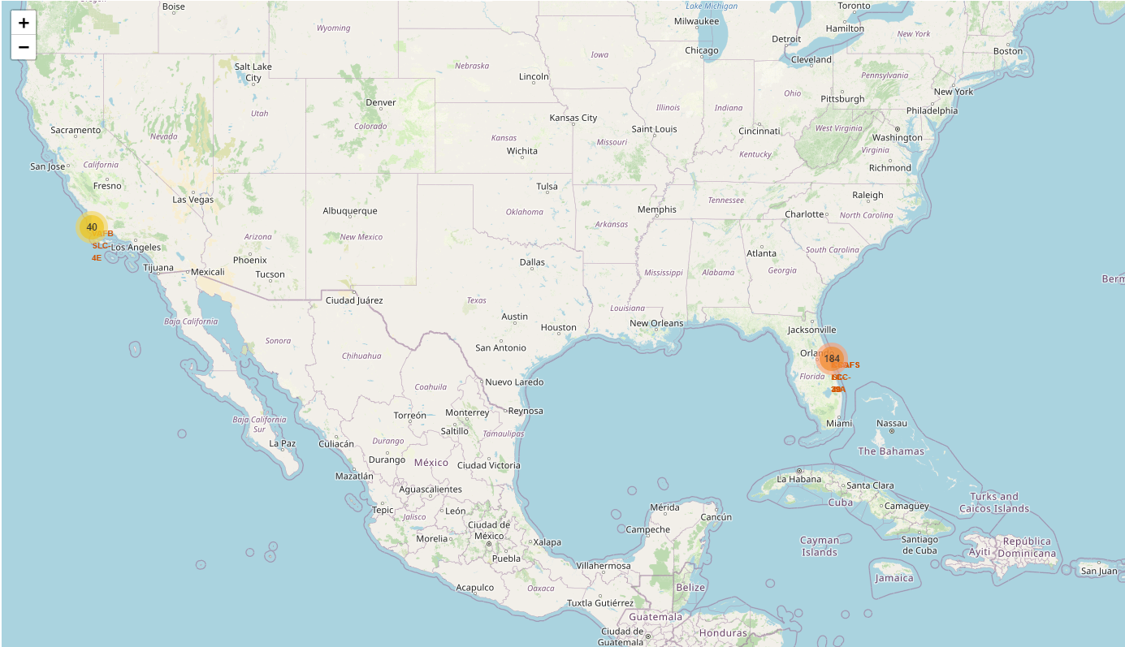
Success/Fail Launch map
The site with most success is KSC LC-39A.

Slide 38
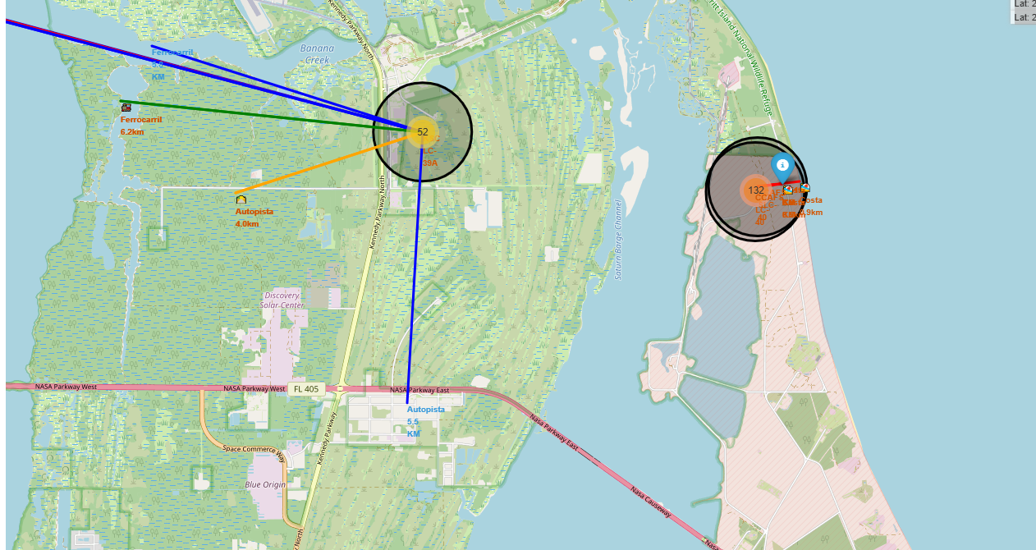
Proximity map
Any location or human mobility route is kilometers away, while the coast is always the closest.

Slide 39

Section 4

Slide 40
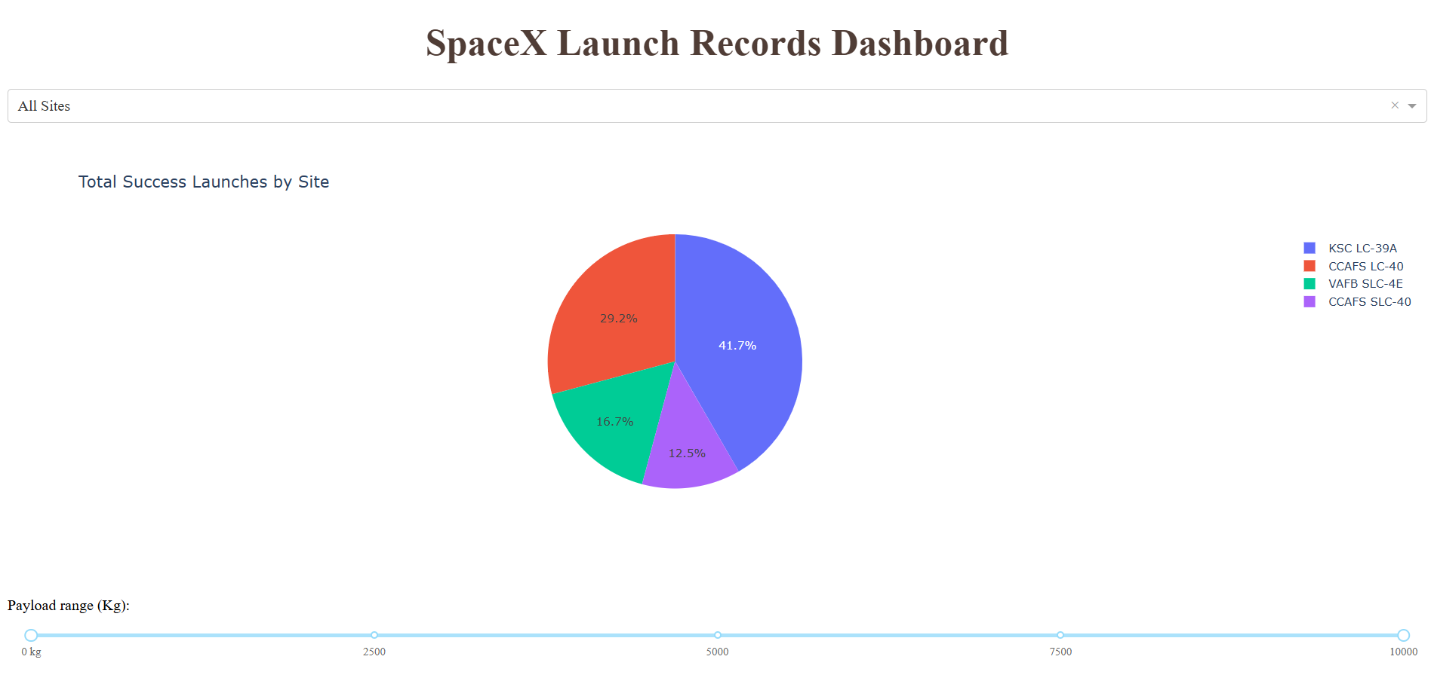
All sites pIECHART
The site "KSC LC-39A" is the most successful one

Slide 41
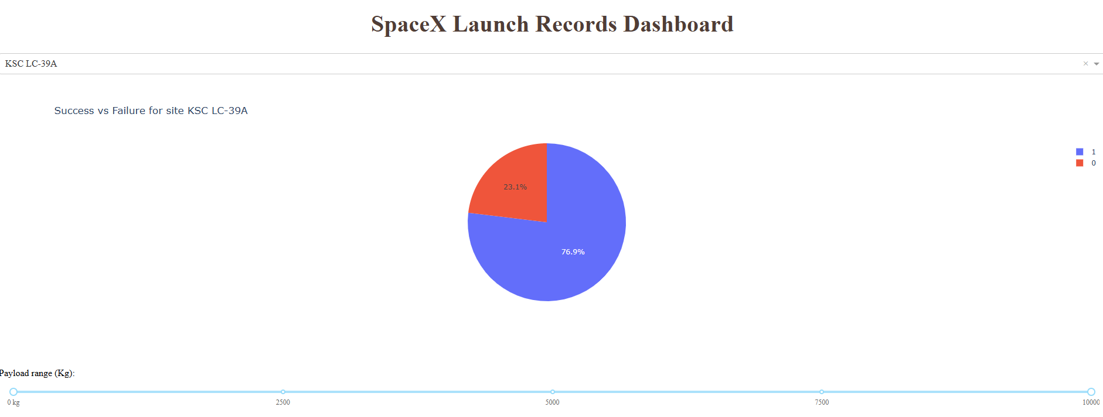
KSC LC-39A Launch site success rate
More than 75% launches are successful in this site, the best site so far.

Slide 42
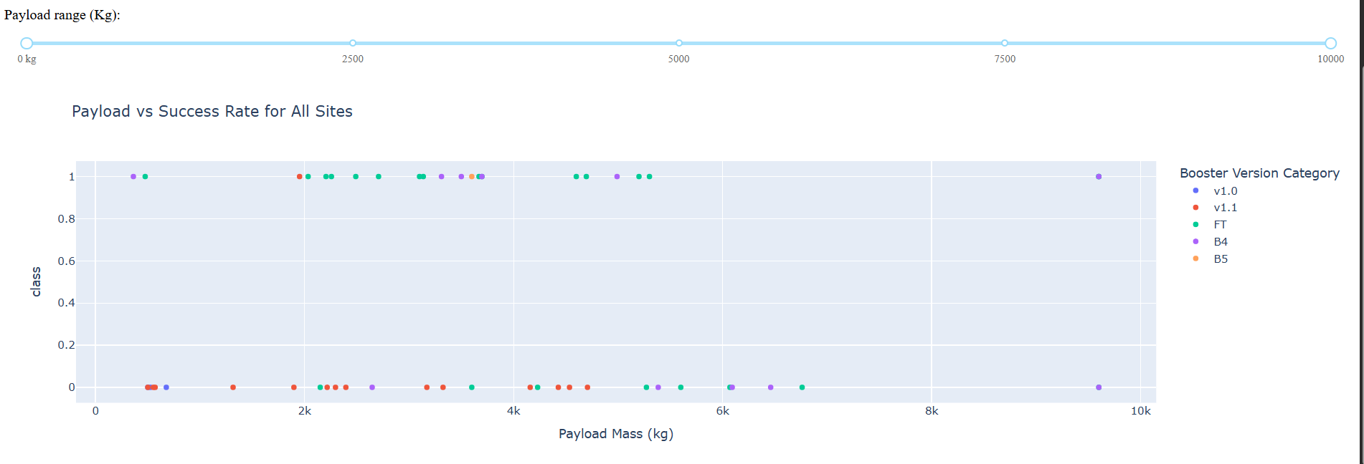
Scatter Plot: Payload vs. Launch Outcome
The highest launch success rate is for 0-5000 kg Payload, which means the worst rate is for 5000-10000 kg Payload.
Also the booster version with the highest launch rate is 'FT'.

Slide 43

Section 5

Slide 44
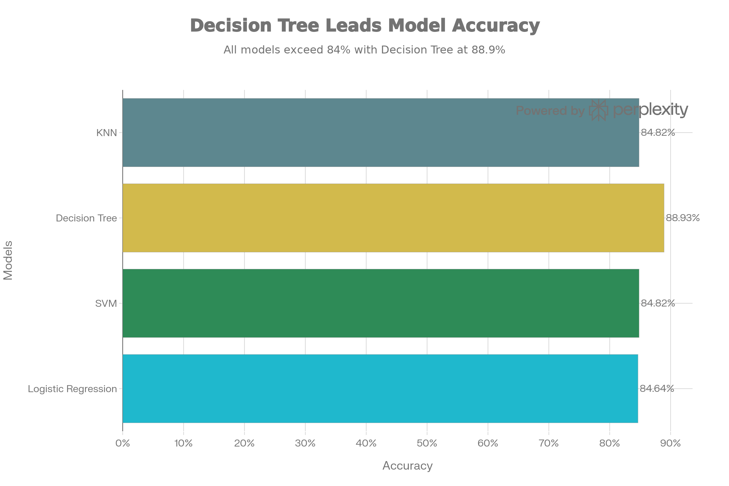
Classification Accuracy
Decision Tree has the best accuracy on training set

Slide 45
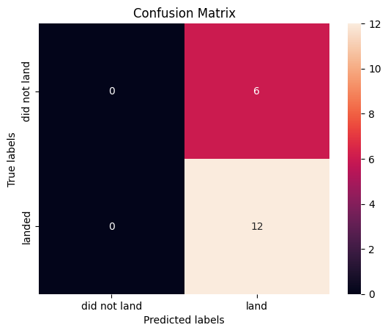
Confusion Matrix
The confusion matrix yields worse accuracy than the other models because the number of samples in the test set is small; this model improves accuracy as the number of samples increases.
Acurracy: 66%

Slide 46
Conclusions
The project demonstrates a complete data science pipeline that reveals key patterns in Falcon 9 reusability.
CCAFS SLC-40 leads in success rates (>90%), optimal payloads of 4-6k kg correlate with higher landing success, and accuracy improves over time since 2013.
Dominant factors include Launch Site, Orbit Type (high success in LEO and SSO), and Payload Mass, validated through EDA using Folium, Dash, SQL, and visualizations.
On the training dataset, the Decision Tree model achieved the highest accuracy at 88%, though it dropped to 66% on test data due to overfitting. Logistic Regression, SVM, and KNN models reached 83% test accuracy with better generalization, and SVM excelled due to balanced precision/recall across classes.

Slide 47
Appendix
All files used to make this presentation are stored here: https://github.com/AValdavida/Test-Repo
To explore and analyze the data, both Python and SQL have been used with the necessary visualizations, already shown in this presentation.
An example of an SQL query used through Python:
%%sql SELECT AVG(PAYLOAD_MASS__KG_)
FROM SPACEXTABLE
WHERE Booster_Version = 'F9 v1.1';

Slide 48
Appendix
All files used to make this presentation are stored here: https://github.com/AValdavida/Test-Repo
Machine learning has been used to determine which model is best for data prediction.
A sample/summary of the code (python) used in the ML analysis process is shown below:
from sklearn.ensemble import DecisionTreeClassifier
from sklearn.model_selection import train_test_split
X_train, X_test, y_train, y_test = train_test_split(X, y, test_size=0.2)
dt = DecisionTreeClassifier().fit(X_train, y_train) # Achieved 88% train accuracy
print(f"Train Acc: {dt.score(X_train, y_train):.2f},
Test Acc: {dt.score(X_test, y_test):.2f}")

Slide 49


